Slide 1
PRESENTATION ON LEAD SCORING CASE STUDY
Submitted By:-
Gunjan Bhardwaj
Neha B
Rohit Singh

Slide 2
Problem Statement :-
An education company named X Education sells online courses to industry professionals. On any given day, many professionals who are interested in the courses land on their website and browse for courses. They have process of form filling on their website after which the company that individual as a lead.
Once these leads are acquired, employees from the sales team start making calls, writing emails, etc. Through this process, some of the leads get converted while most do not.
The typical lead conversion rate at X education is around 30%. Now, this means if, say, they acquire 100 leads in a day, only about 30 of them are converted. To make this process more efficient, the company wishes to identify the most potential leads, also known as Hot Leads.
If they successfully identify this set of leads, the lead conversion rate should go up as the sales team will now be focusing more on communicating with the potential leads rather than making calls to everyone
Business Objective :-
Lead X wants us to build a model to give every lead a lead score between 0 -100 . So that they can identify the Hot leads and increase their conversion rate as well.
The CEO want to achieve a lead conversion rate of 80%.
They want the model to be able to handle future constraints as well like Peak time actions required, how to utilize full man power and after achieving target what should be the approaches.

Slide 3
Problem solving Approach Overview:-
Dataset Reading and Inspection
-Reading the Data set
-Inspecting the data
-Checking data dimensions
-Checking for All data types
-Checking continuous values distribution
-Checking for Null value content
Data Cleaning and Exploratory data Analysis
-Checking for null values
-Removing all columns above 40% Null values and having high imbalance.
-Imputing the categorical columns with Mode after checking &Creating new sub-categories if required.
-Dropping rows with null values content as they have >2% null value content
-Performing Univariate analysis of continuous variables and checking outliers
- Performing Bi-variate Analysis
Data Preparation and Splitting.
-Converting categorical data to binary
-Dummy variables for Multi-categorical data
-Splitting the data into test and train set in 30:70 ratio.
- Scaling the continuous variables.
Model Building, Assigning lead scores and checking performance metrics
-Building the model on the train Data set.
- Using RFE(Recursive feature elimination)
-Model Building using features selected by RFE
- Evaluating all the metrics.
- Calculating optimal cut-off
-Making predictions and generating lead score on train data
- Making predictions of the test data and checking metrics

Slide 4
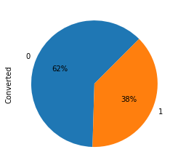
Checking the Data Distribution :-
As it is clearly evident from the chart that the lead conversion rate is low at 38% of the current data set. This is Business that Lead X education is facing at the moment and we are here to tackle that only.

Slide 5
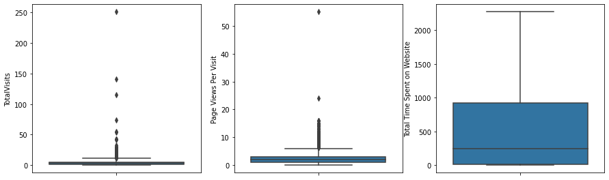
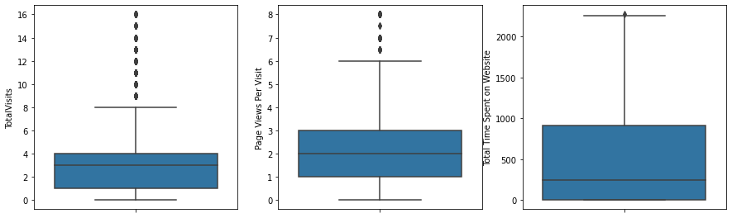
Outliers treatment :-
Total Visits
Page Per views per Visits
Total time spent on website
As we can see and conclude that there are outliers present in some of the continuous type data columns. So we removed all the values above 99% percentile in Total visits and Page per view per Visits columns. Later we get the below mentioned distributions. Which shows a better distribution of the two columns.
Total Visits
Page Per views per Visits
Total time spent on website

Slide 6
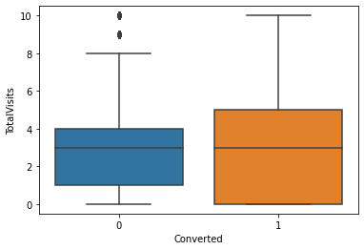
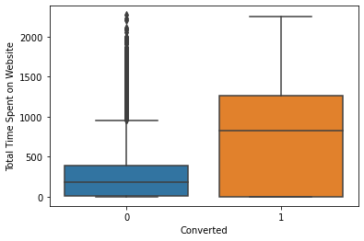
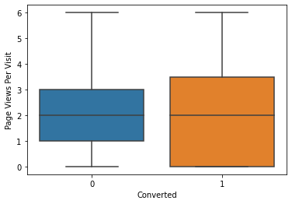
Relationship between Conversion and Website stats
Total Visits
Total time spent on website
Page Per views per Visits
It is Clearly visible in the above plots that the there is a high rate of lead conversion of the leads that spent more time on the website as it has high median for converted leads. Total visits and Page per view per visit have an equal distribution of the leads conversion rate.

Slide 7
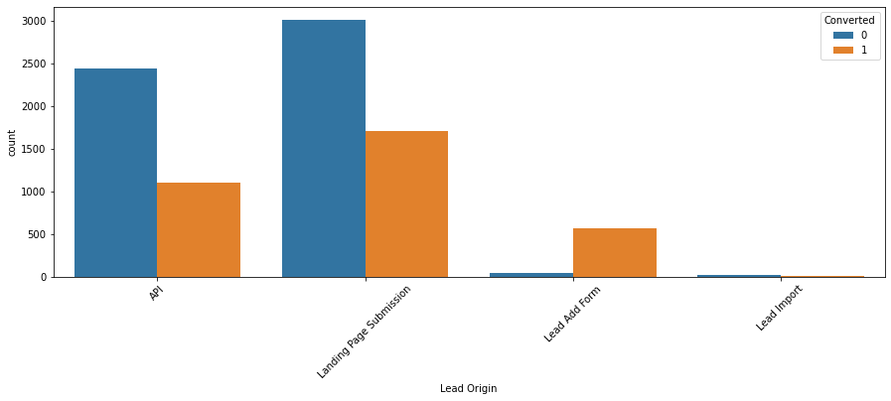
Relationship between Lead Origin and Conversion:-
Lead Origin Distribution
As it can be seen from the plot above that most of the Lead converted are from Landing page submission followed by API. But Lead add form has an excellent conversion rate. Lead import has very less and data available.

Slide 8
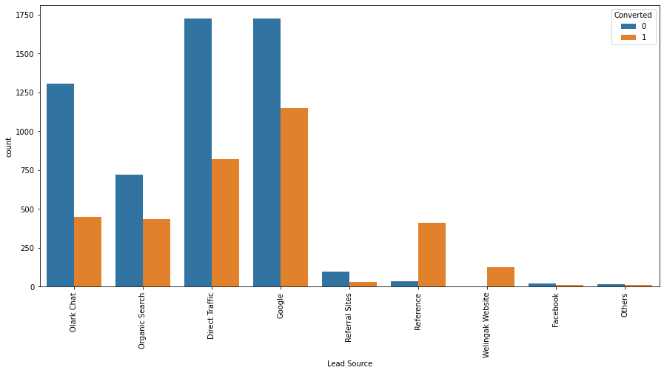
Relationship between Lead Source and Conversion:-
Lead Source Distribution:-
We see max number of leads are generated by google / direct traffic. Max conversion ratio is by reference and welingak website.

Slide 9
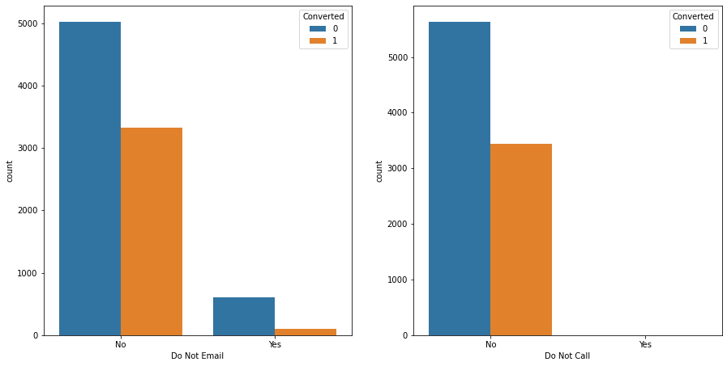
Do not Email/Call with conversion:
Do Not Email :-
Do Not Call :-
In case of Do not call and Do not email both the variables has a high inclination towards no and both of them has a poor lead conversion rate.

Slide 10
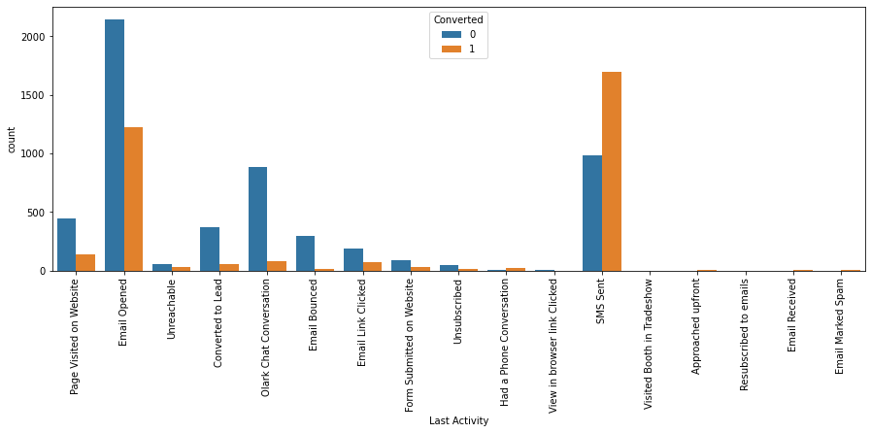
Last activity vs Conversion
Last Activity:-
Most of the leads are generated from the SMS sent activity followed by Email opened activity rest all categories has very poor conversion rate of leads. Many categories like Approached upfront, visited booth is tradeshow & email marked spam etc. have very less or negligible data available.

Slide 11
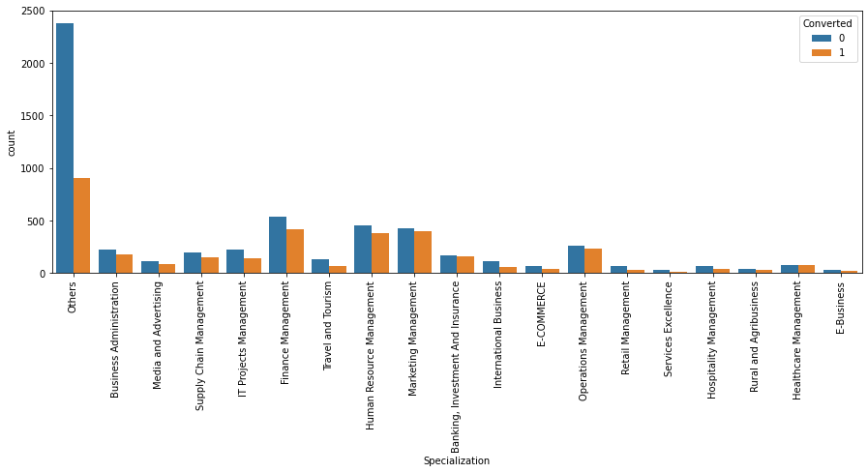
Specialization Vs Conversion
Specialization:-
Most of the Management specialization professionals have opted for further courses or shown more interest. There are some high response from an unlabelled category we need to get the details of that by making this an necessary entry in the online form

Slide 12
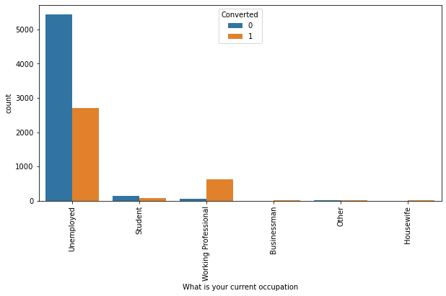
Occupation vs Conversion
What's your current occupation
Maximum leads are from unemployed category. Max conversion with working professionals.

Slide 13
Data Preparation
Creating dummy variable columns for multicategory categorical variable.
Converting bi-categorical variable to 1 and 2.
Scaling value variables by Standardisation

Slide 14
Making and Optimizing the model
Feature selection Via RFE
Manual Feature selection and feature elimination by P value and VIF evaluation.
Predicting and evaluating Y train via model using accuracy, sensitivity and specificity.
Predicting Y test and running evaluation matrices.

Slide 15
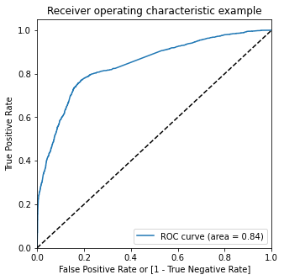
Evaluation Matrices
Precision – Recall trade-off
Accuracy
Sensitivity, specificity and %ages of False positive and false negative.
ROC curve

Slide 16
Observations:
Train Data: Accuracy : 80% Sensitivity : 77% Specificity : 80%
Test Data: Accuracy : 80% Sensitivity : 77% Specificity : 80%
Final Features list: Lead Source_Olark Chat
Specialization_Others
Lead Origin_Lead Add Form
Lead Source_Welingak Website
Total Time Spent on Website
Lead Origin_Landing Page Submission
What is your current occupation_Working Professionals
Do Not Email

Slide 17
Inferences:
We see that the conversion rate is 30-35% (close to average) for API and Landing page submission. But very low for Lead Add form and Lead import. Therefore we can intervene that we need to focus more on the leads originated from API and Landing page submission.
We see max number of leads are generated by google / direct traffic. Max conversion ratio is by reference and welingak website.
Leads who spent more time on website, more likely to convert.
Most common last activity is email opened. highest rate = SMS Sent. Max are unemployed. Max conversion with working professional.

